Slide 1
Simulating Road Traffic
Joshua Fatimilehin-Tulip
Felipe Tcach

Slide 2
aims
Model a variety of traffic simulations, including closed-loop roads, junctions and buses
Devise methods to present traffic behaviour visually
Calculate the rates of flow of traffic simulations and the optimal density for flow
Find the most efficient frequency for traffic lights to change (maximising flow)

Slide 3
Method
Coding in Python 3.9 (using the Spyder 5 IDE)
Co
Use
Obtain values

Slide 4
Set-up

Slide 5
results

Slide 6
results
Raw data

Slide 7
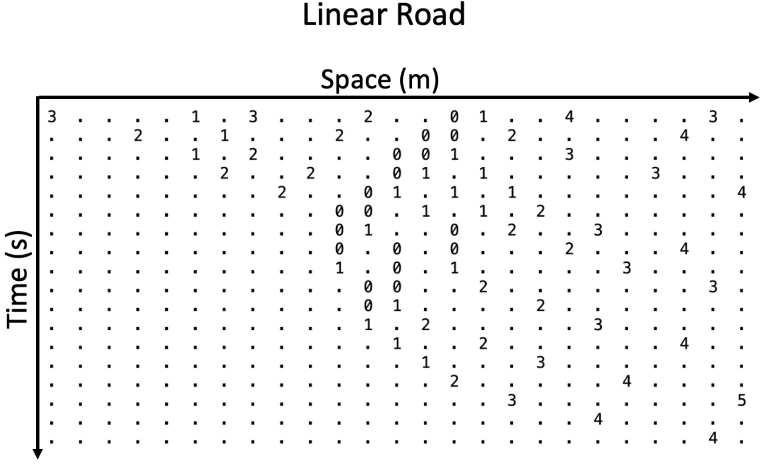
Results

Slide 8
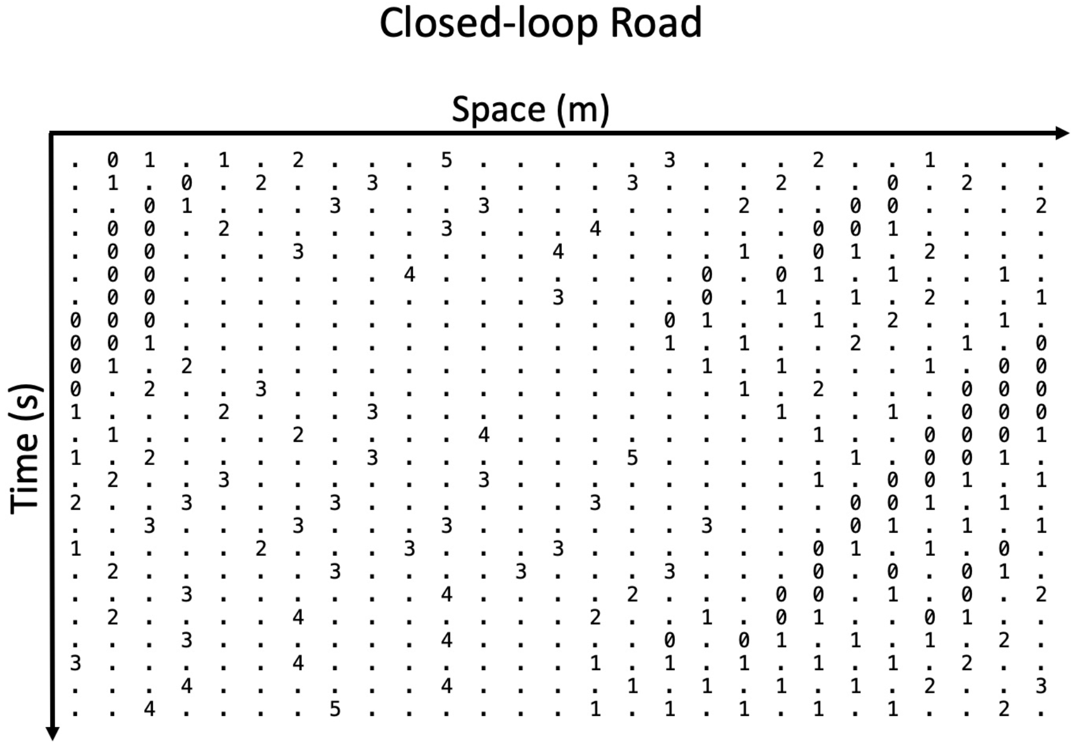
Data analysis
.

Slide 9
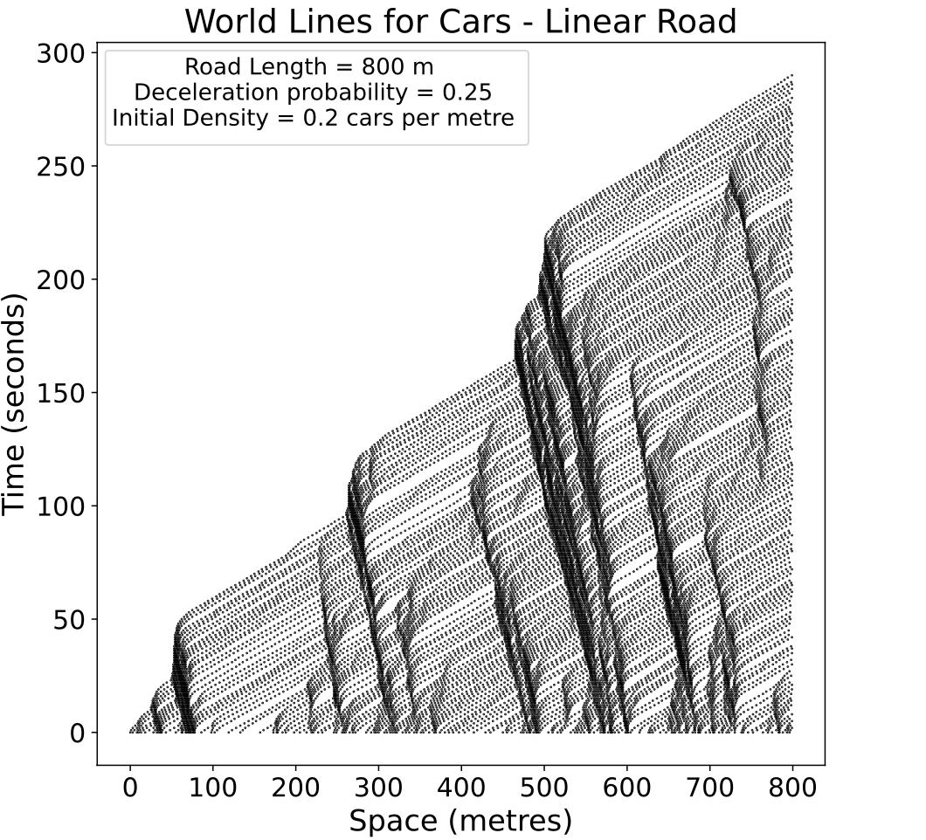
Data analysis
.

Slide 10
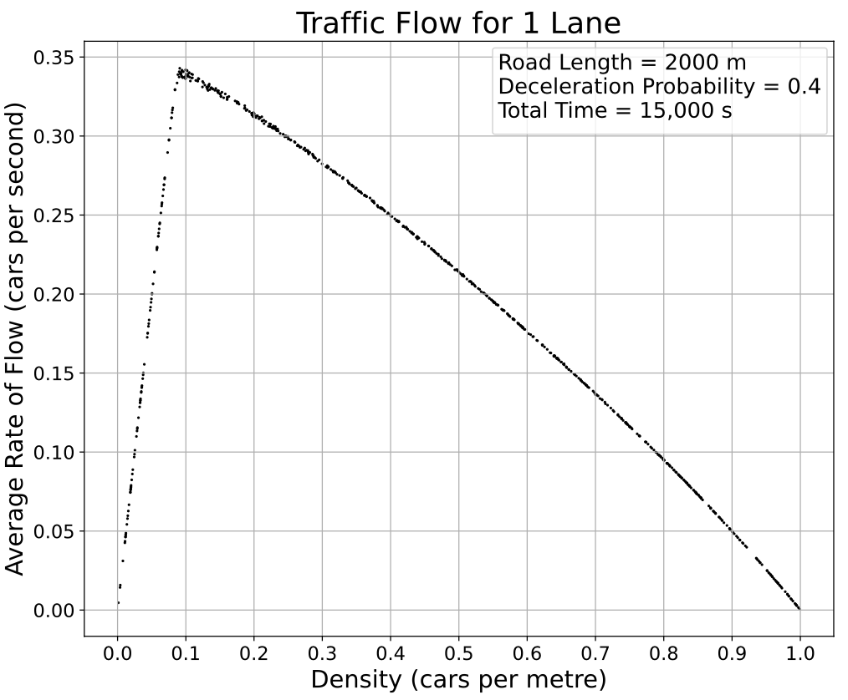
Data analysis
.

Slide 11
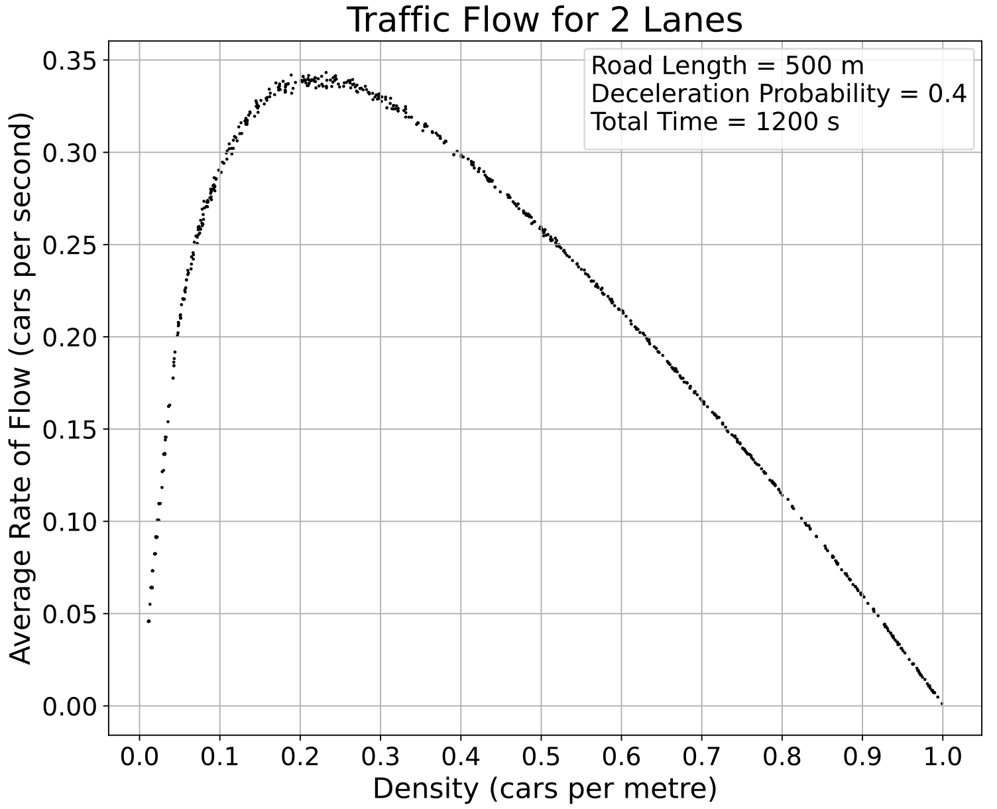
Data analysis
.

Slide 12
Data analysis
.

Slide 13
Data analysis
.

Slide 14
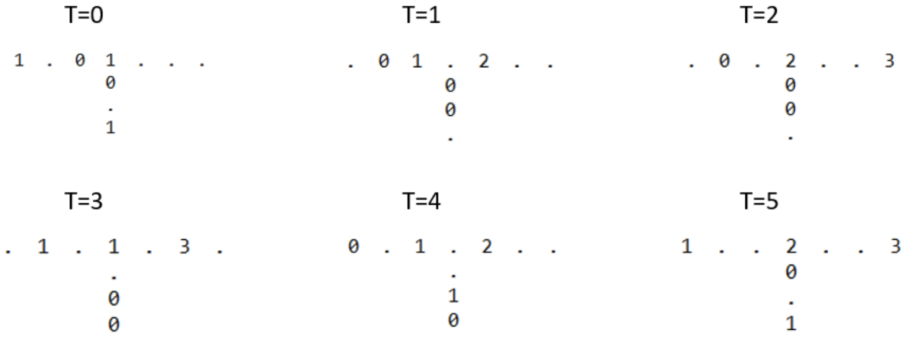
Results
.

Slide 15
Data analysis
.

Slide 16
Data analysis
.

Slide 17
Data analysis
.

